Slide 1

OTGC Onboarding Tool and Generic Client Hands-on Training of OTGC
OCF EU Developer Training 2019
DEKRA Testing and Certification, S.A.U.
Diego Bartolome (diego.bartolome@dekra.com)

Slide 2
Terms and Definitions (I)
Onboarding Tool (OBT)
A logical entity within a specific IoT network that establishes ownership for a specific device and helps bring the device into operational state within that network. A typical OBT implements DOTS (Device Owner Transfer Service), AMS (Access Management Service) and CMS (Credential Management Service) functionality.
Onboarding Tool and Generic Client (OTGC)
A logical entity that implements the functions of an OBT and a Generic Client.
Onboarding
Process that consists in owning an OCF device by the OTGC.
Offboarding
Process that consists in releasing an OCF device owed by the OTGC.

Slide 3
Terms and Definitions (II)
OCF Server
A sensor or actuator capable to generate a measurement or perform an action.
OCF Client
A device capable to scan and control OCF Servers.
OCF Device
A device (Server or Client) that can be integrated into an OCF network created by the OTGC. The OTGC will transfer ownership to this OCF Device by different OTM (Onboarding Transfer Methods).

Slide 4
Architecture
OTGC main code (C / C++)
OS dependent code
(Android)
OS dependent code
(iOS)
OS dependent code
(Windows)
OS dependent code
(Linux)

Slide 5
OTGC Resources
OTGC binaries available publicly at OCF GitHub Developers Area:
https://github.com/openconnectivityfoundation/development-support/tree/master/otgc
Current version v1.2.0 available for Android
Current version v1.3.0 available for Linux OS.
OTGC sources available publicly at OCF GitHub:
OTGC Android ➔ https://github.com/openconnectivity/otgc-android
OTGC Linux ➔ https://github.com/openconnectivity/otgc-linux
OTGC IoTivity ➔ https://github.com/openconnectivity/1.3-rel-iotivity-otgc
OTGC is an open source code so can be modified by manufacturers to incorporate proprietary features and or branding graphical material.

Slide 6
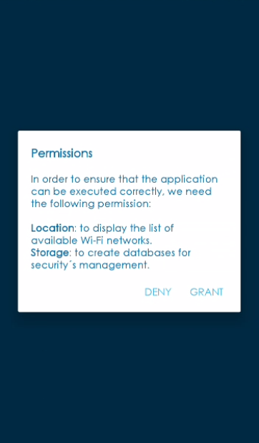
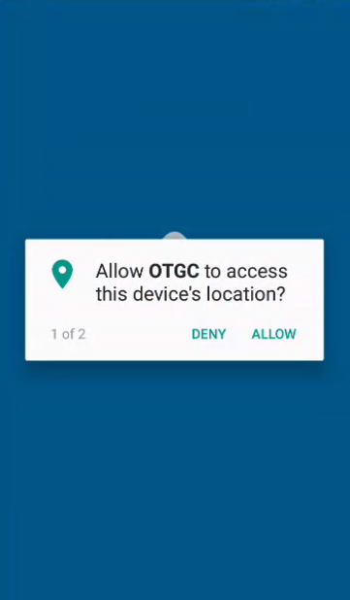
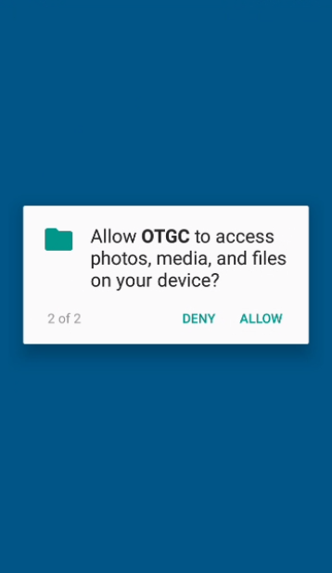
OTGC Installation

Slide 7
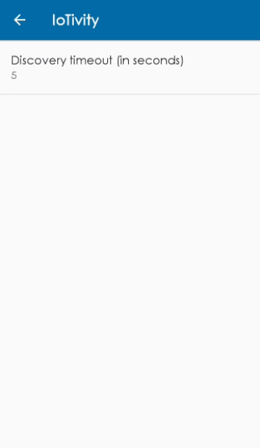
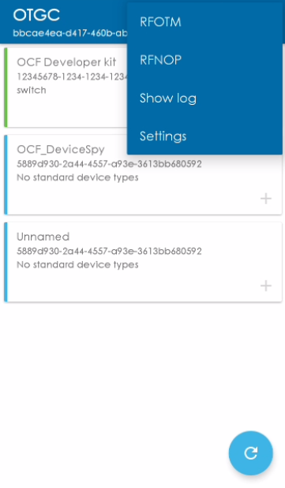

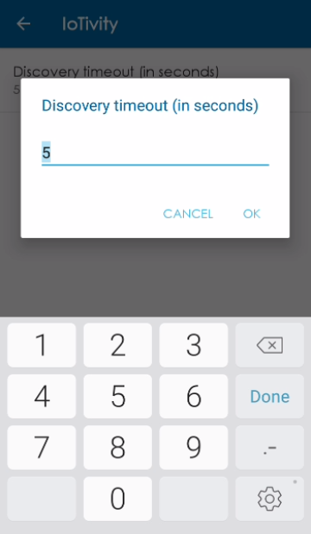
OTGC Settings

Slide 8
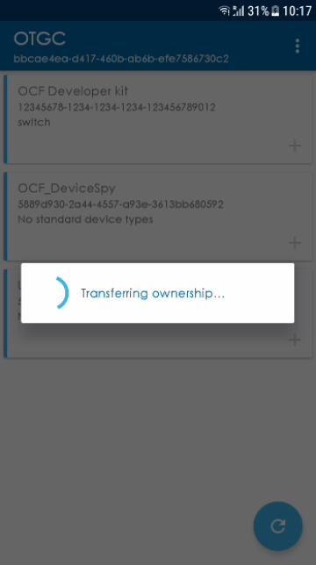
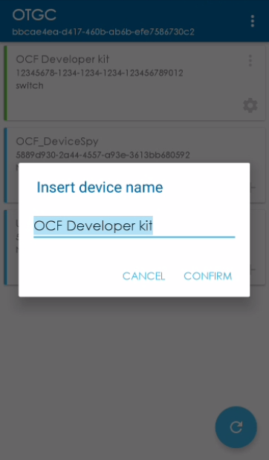
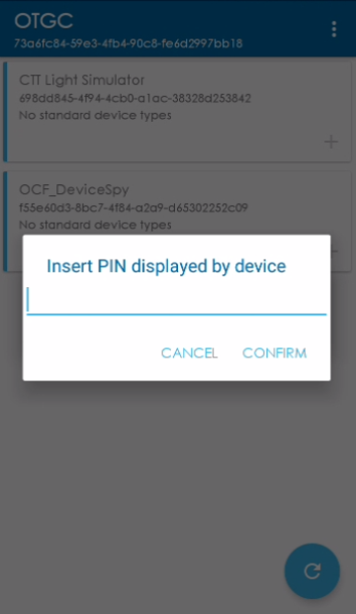
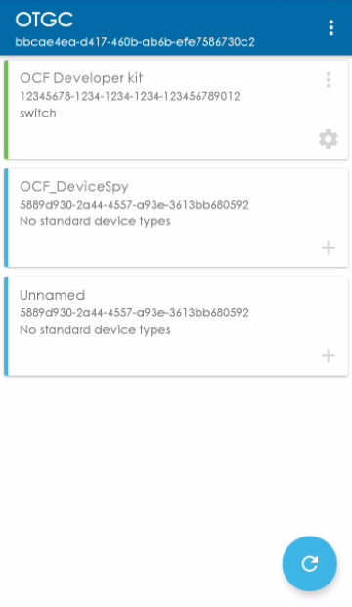
OTGC Scanning + Onboarding

Slide 9
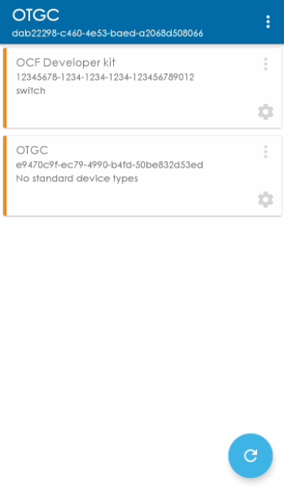
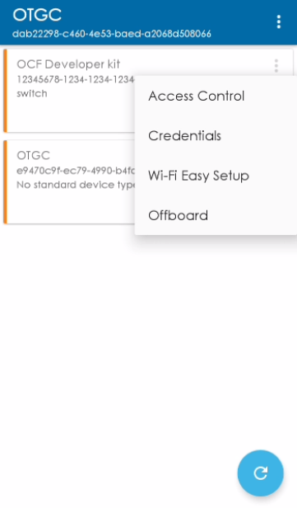
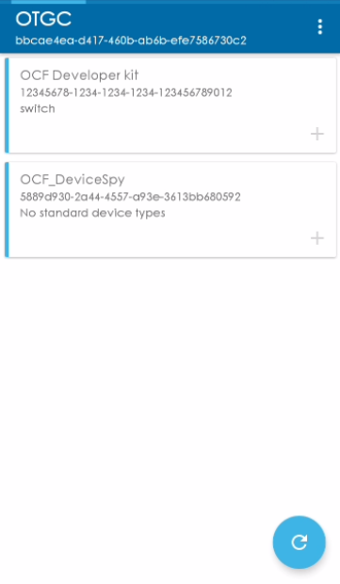
OTGC Device Operation (I)

Slide 10
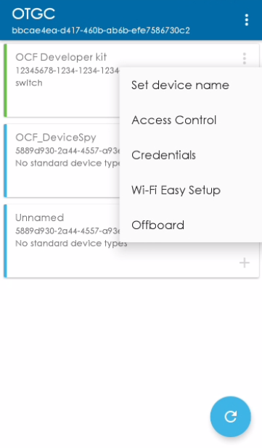
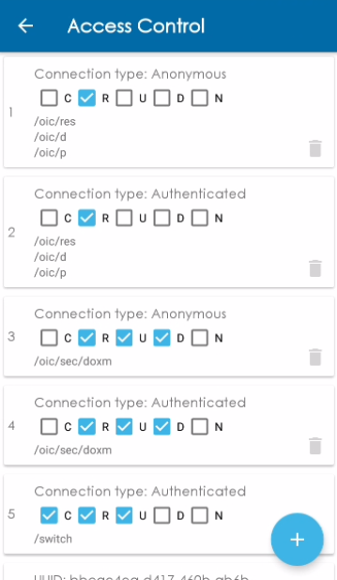
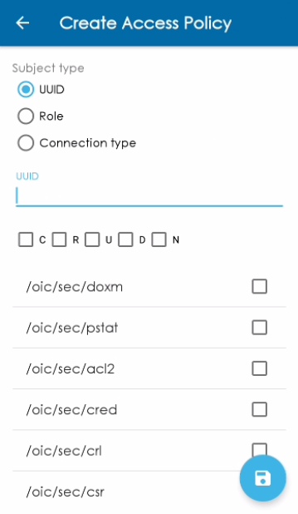
OTGC Device Operation (II)

Slide 11
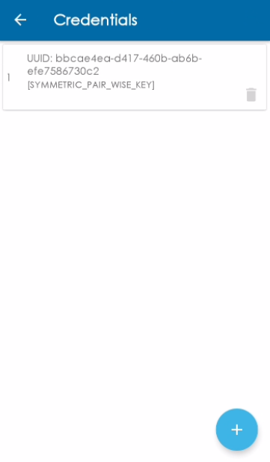
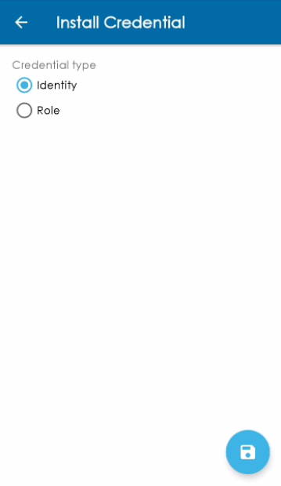
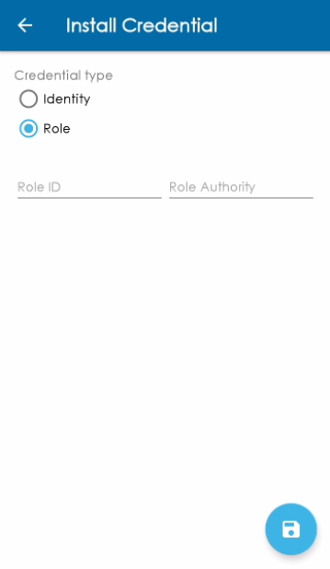
OTGC Device Operation (III)

Slide 12


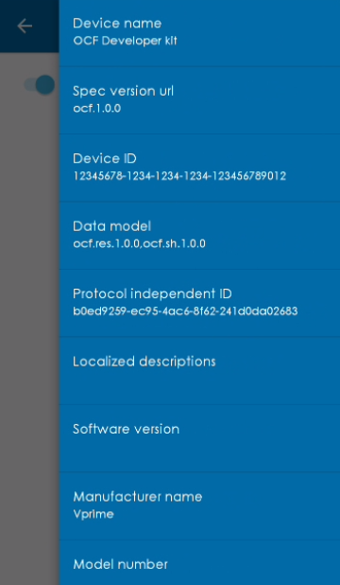
OTGC Device Operation (IV)

